Slide 1
Data analysis
Using Pandas

Slide 2
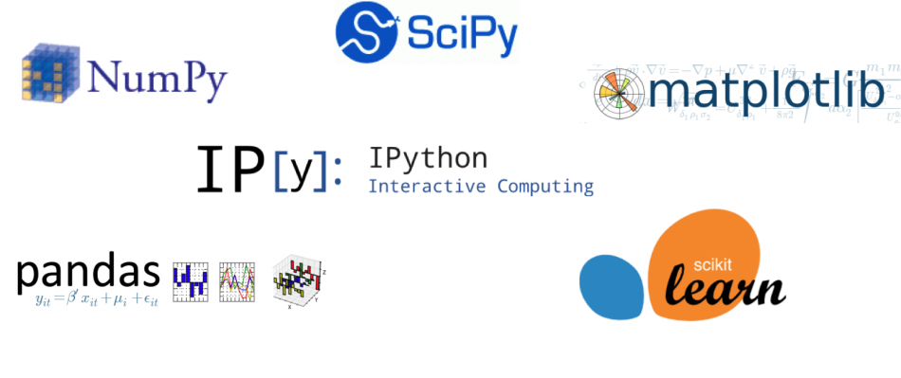
What is a library?
Prewritten code that users can use to optimize tasks

Slide 3

Pandas(tabular data)
Clean data
Explore data
Manipulate data
Analyze data
25/7/80
7/25/1980
X
Y
1
2
3
1
2

Slide 4
2 main Classes
Series(one column)
DataFrame(whole table)
Name
Bob
Tiffany
Alex
Sam
Name | Age | Zip code
Bob | 34 | 12876
Tiffany | 25 | 13442
Alex | 19 | 146742
Sam | 46 | 49008
0
1
2
3
0
1
2
3

Slide 5
Class Series
Class DataFrame
Dtypes
Name
Shape
Values
Dtypes
Axes
Loc
Values
Attributes
Attributes
Head( )
Filter( )
Fillna( )
Head( )
info( )
Pop()
Fillna( )
Methods
Methods

